Slide 1
Blessed Edmund Rice Éamonn Iognáid Rís
1 June 1762 – 29 August 1844
Notes:
Blessed Edmund Ignatius Rice, was a Roman Catholic missionary and educationalist. Edmund was the founder of two religious institutes of religious brothers: the Congregation of Christian Brothers and the Presentation Brothers.

Slide 2
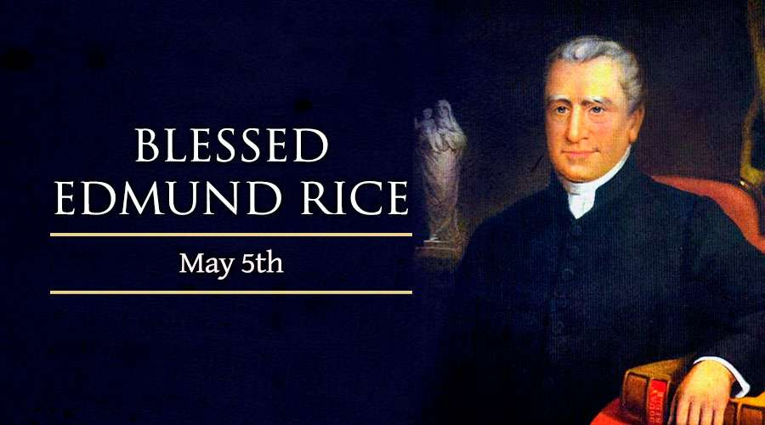

Slide 3
Edmund Rice was born in the town of Westcourt near the village of Callan in County Kilkenny in the south east of Ireland on 1 June 1762.

Slide 4
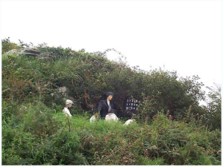
As a result of the Penal Laws, Edmund was forced to receive his primary school education from a “hedge school”. These were illegal schools established by travelling teachers, usually only one teacher was in each.

Slide 5
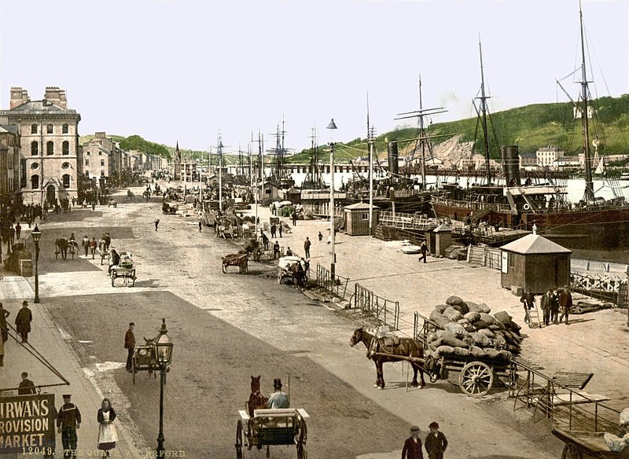
In 1779, Edmund began an apprenticeship with his uncle. Michael Rice, who owned a very successful merchant trading business in Waterford city. Waterford was the second busiest shipping port in the world at the time. Michael died in 1785, and the business was passed into Edmund’s ownership.

Slide 6
Blessed Edmund Ignatius Rice, was a Roman Catholic missionary and educationalist. Edmund was the founder of two religious institutes of religious brothers: the Congregation of Christian Brothers and the Presentation Brothers.

Slide 7
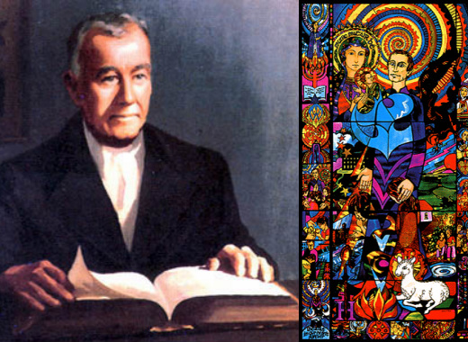
Born in Callan, Ireland, in 1762, Edmund came to the bustling city port of Waterford as a young man. He was talented and energetic and soon became very wealthy.

Slide 8
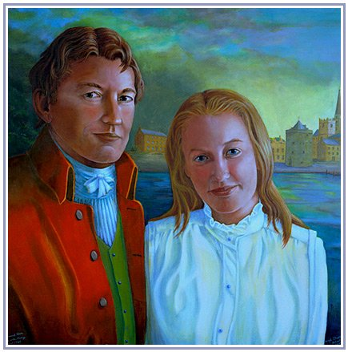
Married to Mary Elliot, in 1789 he experienced her tragic death soon after she gave birth to their daughter Mary. Deeply saddened by her loss, Edmund entered a time of mourning. As his daughter continued to open the depths of his love, his relationship with God deepened.

Slide 9
In his own brokenness, he was moved with compassion to recognise the brokenness of those around him. He entered more deeply into their struggle and found in the story of Jesus the call to liberation that is at the heart of what Jesus preached.

Slide 10
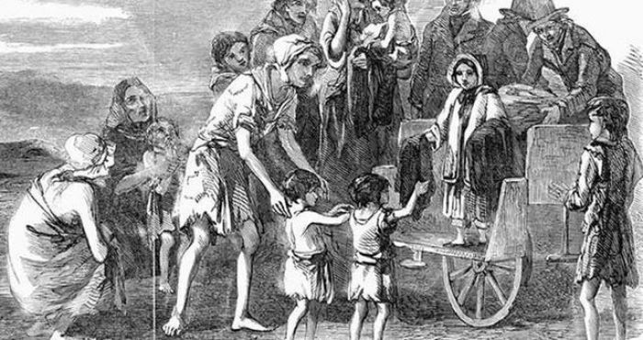
The Ireland of Edmund’s day was an unjust place where many lived in poverty and social structures deeply oppressed the majority of the population. In 1802 he set up a free school for boys living in poverty.

Slide 11
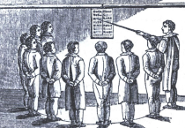
In 1802 he set up a free school for boys living in poverty. His aim was to promote an education that recognised the dignity of each individual and thus he sought to liberate them from their ignorance of God and of their Catholic faith, while at the same time empowering them with an education which would enable them to rise from the demeaning poverty and sense of hopelessness in which they were trapped.

Slide 12
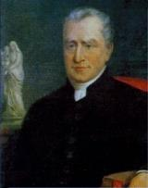
Edmund sought to liberate individuals and indeed to free his society from oppression.

Slide 13
Edmund’s spirituality is characterised by a simple but profound trust in God. Edmund said often, “Providence is our inheritance!” Many of his letters invite the recipient to turn to God and trust in God in times of hardship.

Slide 14
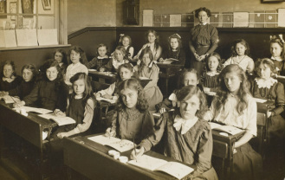
. Edmund helped The Presentation Sisters in Waterford to build a school and convent for girls. It was suggested to Edmund that he do something similar for the poor boys of Waterford.

Slide 15
In 1797, the then Bishop of Waterford, Dr Hussey, published a Pastoral letter which encouraged the establishment of Catholic schools for the poor

Slide 16
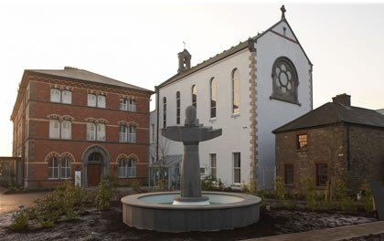
.Inspired by the Pastoral Letter of Bishop Thomas Hussey on Catholic Education and Nano Nagle and her Sisters of the Presentation, Edmund wound up his business and opened his first school at Waterford in 1802

Slide 17
The Eight Essentials of Edmund Rice Education
Evangelising the Modern World.
Promoting the Spiritual.
Building a Christian Community.
Compassion for those in Need.
Concern for the Whole Person.
Striving for Excellence.
Education as a Christian Calling.
Education for Justice.

Slide 18
Inspired by the spirit of Edmund so alive in this place today.We as colleagues in the Edmund Rice network,Dedicate ourselves to work together in our
Inspired by the spirit of Edmund so alive in this place today.We as colleagues in the Edmund Rice network,Dedicate ourselves to work together in our

Slide 19
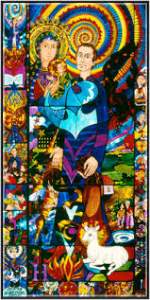
Edmund Rice Prayer
O God, we thank you for the life of Edmund Rice.
He opened his heart to Christ present in those
Oppressed by poverty and injustice.
May we follow his example of faith and
generosity. Grant us the courage and compassion of Edmund
As we seek to live lives of love and service.
We ask this through Christ our Lord,
Amen

Slide 20
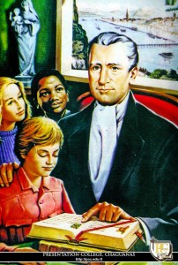
He was successful because he was a man of compassion and love

