Slide 1
Learning with iPad

Slide 2
Academia : Northern Ireland
Local Offices throughout UK
Local Bases in Northern Ireland
98 current Team members

Slide 3
Year 13 iPad Scheme for Abbey CBS
“A cash purchase or monthly contribution scheme.”

Slide 4
Year 13 iPad Scheme
iPad Air 2 16GB Device
Protective Cover
Extended Warranty on Device
Insurance cover for Accidental
Damage.

Slide 5
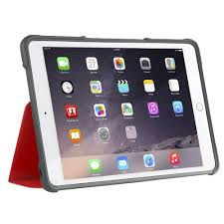
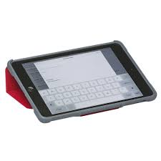
Protective Case
STM Dux cover
Protective Cover approved
by insurance provider
Camera cut out and two
stand positions

Slide 6
Options on iPad Scheme
Pay Monthly over 20 Months
Outright Purchase / One off payment
Buy Insurance and extended warranty cover for personal owned iPad device.

Slide 7
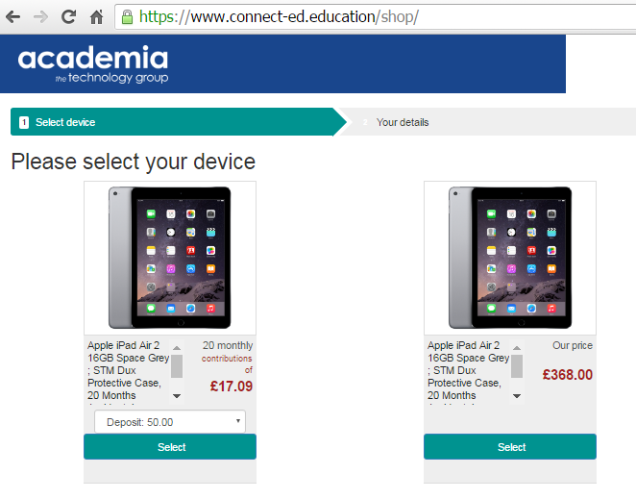
When log on portal
Code with Warranty
Code without Warranty

Slide 8
Scheme Benefits
No credit checks
School contributing 20% of total cost!
Devices Managed by School – Pupil Safety
Cheaper than if bought on high street

Slide 9
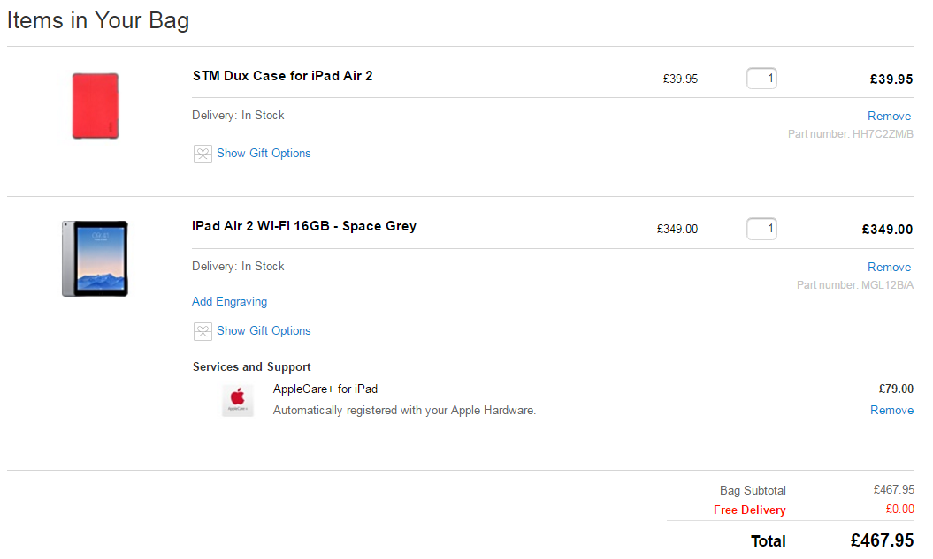
COST From Apple Store / Website
NO insurance selected !
NO insurance selected !

Slide 10
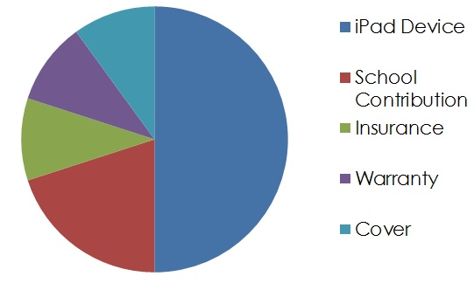
Having a School Contribution Means total = £398

Slide 11
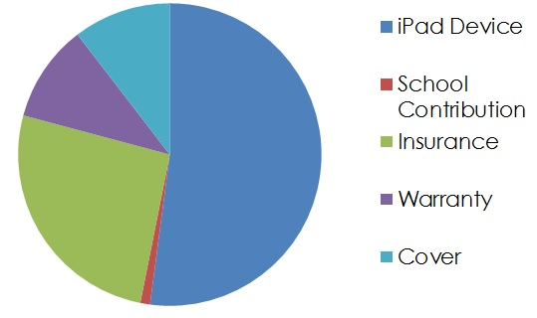
No School Contribution Means total = £477.60

Slide 12
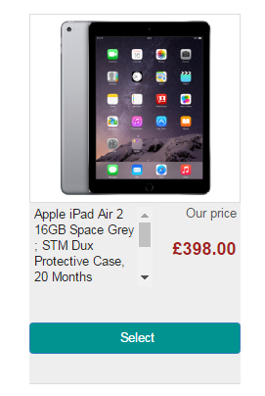
High Street Comparison
iPad Air 2, 16GB Wi-Fi model, Outright Purchase Option
£398.00
With scheme offered this price
INCLUDES 20 Months Accidental Damage Insurance,
and still £69.95 cheaper !!!

Slide 13
Payment Summary
Portal for purchase is open from Tuesday 30th August
Portal will be closed on Thursday 08th September.
Payments for Outright Purchase collected on day of purchase.
Payments for Monthly Contributions will be collected by 01st October. Deposit is collected in 1st Monthly payment

Slide 14
Portal management
Support Line :
01992 662 846
Portal user guide link on
School Website

